Slide 1
Discover Your Future with CSC: Company Overview & Opportunities

Slide 2
Agenda
1
About Us
1
Global Footprint
1
We’re in it to win it!
1
CSC Differentiators
1
A brief overview of CSC
1
Defining the hiring process
1
Most common hiring questions
1
What do you want to know?
1
Closing
Notes:
[JUSTIN]
Overview of the topics we’ll be covering in the webinar
What we hope attendees will come away with after this presentation

Slide 4
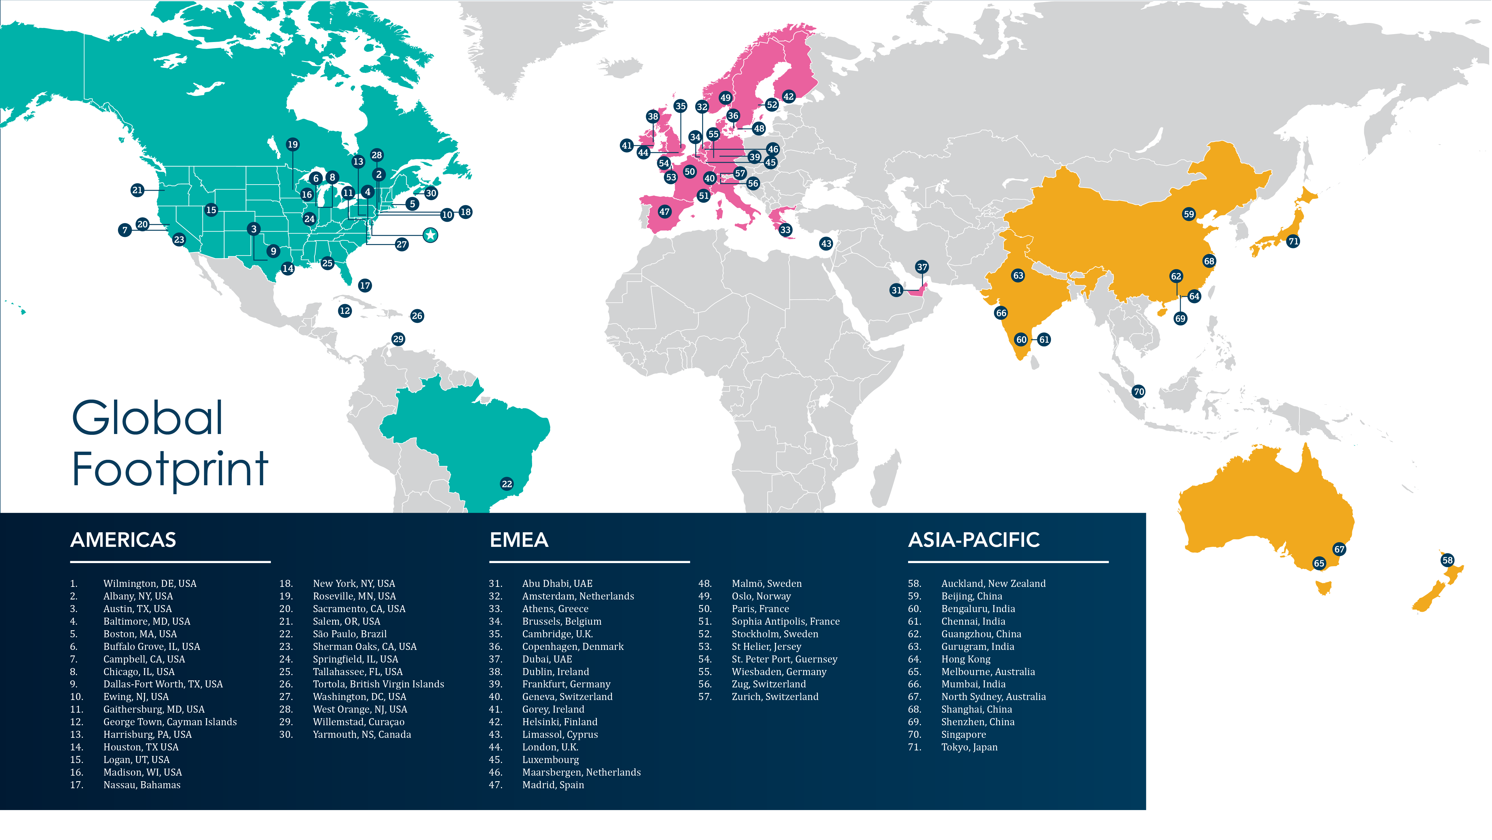

Slide 6
April 21, 2025 | Proprietary and Confidential
6

Slide 7
We are the Business Behind Business®
Established in 1899, CSC is a privately held business headquartered in Wilmington, Delaware. CSC is an industry-leading international company dedicated to making business easier, less risky, and more profitable.
Top Workplace winner in several locations for multiple years
Office locations and capabilities in more than 140 jurisdictions
More than 8,500 employees evenly distributed across the Americas, Europe-Middle East, and Asia-Pacific regions

Slide 8
Our Values
Service
We are relentless in our pursuit of customer satisfaction. We deliver excellence.
Teamwork
We produce superior results by working together inclusively. We believe that 1+1>2.
Tenacity
We make quick informed decisions, take action, and stick with it until the job gets done. We find the best way.
Agility
We challenge the status quo, embrace change, adapt, and innovate. We are never complacent.
Genuine
We are straightforward, open, and honest, with the highest levels of integrity and care. We build trust.
Notes:
[Sanket]
Overview of CSC values

Slide 9
Empowering Growth: Our Comprehensive Approach to Colleague Development in India
Mentorship matters
Leader-led mentorship
Skill enrichment
Career growth opportunities
Leadership speaker series
Skill enhancement workshops
Internal mobility
Job rotation initiatives
Internal job fairs
1
1
1
1
2
3
Localization for India
Cultural sensitivity
Language accessibility
Inclusion in the colleague journey
Colleague experience integration
Collaborative development culture
Way forward
Build communication strategy
Recognition program
1
1
1
4
5
6
Notes:
Slide Content:
1. Mentorship matters:
Leader-led mentorship: Engaging leaders as mentors to guide and inspire. We’re building solid mentor-mentee relationships.
Skill enrichment: Regular mentor-mentee meetings for personalized skill development. We’re leveraging leaders' expertise for hands-on learning.
2. Career growth opportunities:
Ongoing workshops: We conduct regular workshops for skill enhancement. Addressing career planning, interview skills, and resume building.
Leadership speaker series: Insights from successful leaders to inspire career aspirations. Interactive sessions for direct engagement with leaders.
3. Internal mobility:
Job rotation initiatives: Encouraging employees to explore diverse roles within the organization. We’re showcasing success stories of internal mobility.
Internal job fairs: Facilitating networking opportunities for career exploration. They’re empowering colleagues to take charge of their career paths.
4. Localization for India:
Cultural sensitivity: We’re incorporating cultural nuances into mentorship and growth initiatives. We’re celebrating Indian festivals and traditions within the program.
Language accessibility: We’re providing resources in local languages for inclusivity. Language-specific communication channels for engagement.
5. Inclusion in the employee journey:
Colleague experience integration: Emphasizing inclusion throughout the colleague journey
Collaborative development culture: Moving beyond back-office mindset for a shared responsibility approach
6. Way forward:
Communication strategy: It informs colleagues about program updates through various channels. We’re building excitement through companywide communication.
Recognition program: We’re showcasing success stories to inspire others.

Slide 10
CSC India: Nurturing Growth, Embracing Balance Amid Challenges
Recognition and rewards: Despite challenges, CSC ensured regular pay increases and bonuses, recognizing and rewarding its workforce’s hard work and dedication.
Values and culture upheld: CSC stood firm in upholding its core values and nurturing a culture prioritizing its greatest asset—its people.
04
Holistic approach to well-being: Beyond professional growth, CSC addressed the toll the pandemic took on employee well-being.
03
05
Job security prioritized: While other companies grappled with layoffs, CSC retained its workforce and doubled its employee count.
Online health sessions: CSC organized a series of online health sessions, going beyond physical health to delve into mental and emotional well-being.
02
06
Resilience amid global pandemic: CSC India emerged as a beacon of resilience and compassion during the global pandemic.
Redefining employer commitment: In the face of adversity, CSC upheld its values and redefined what it meant to be an employer committed to its workforce.
01
07

Slide 11
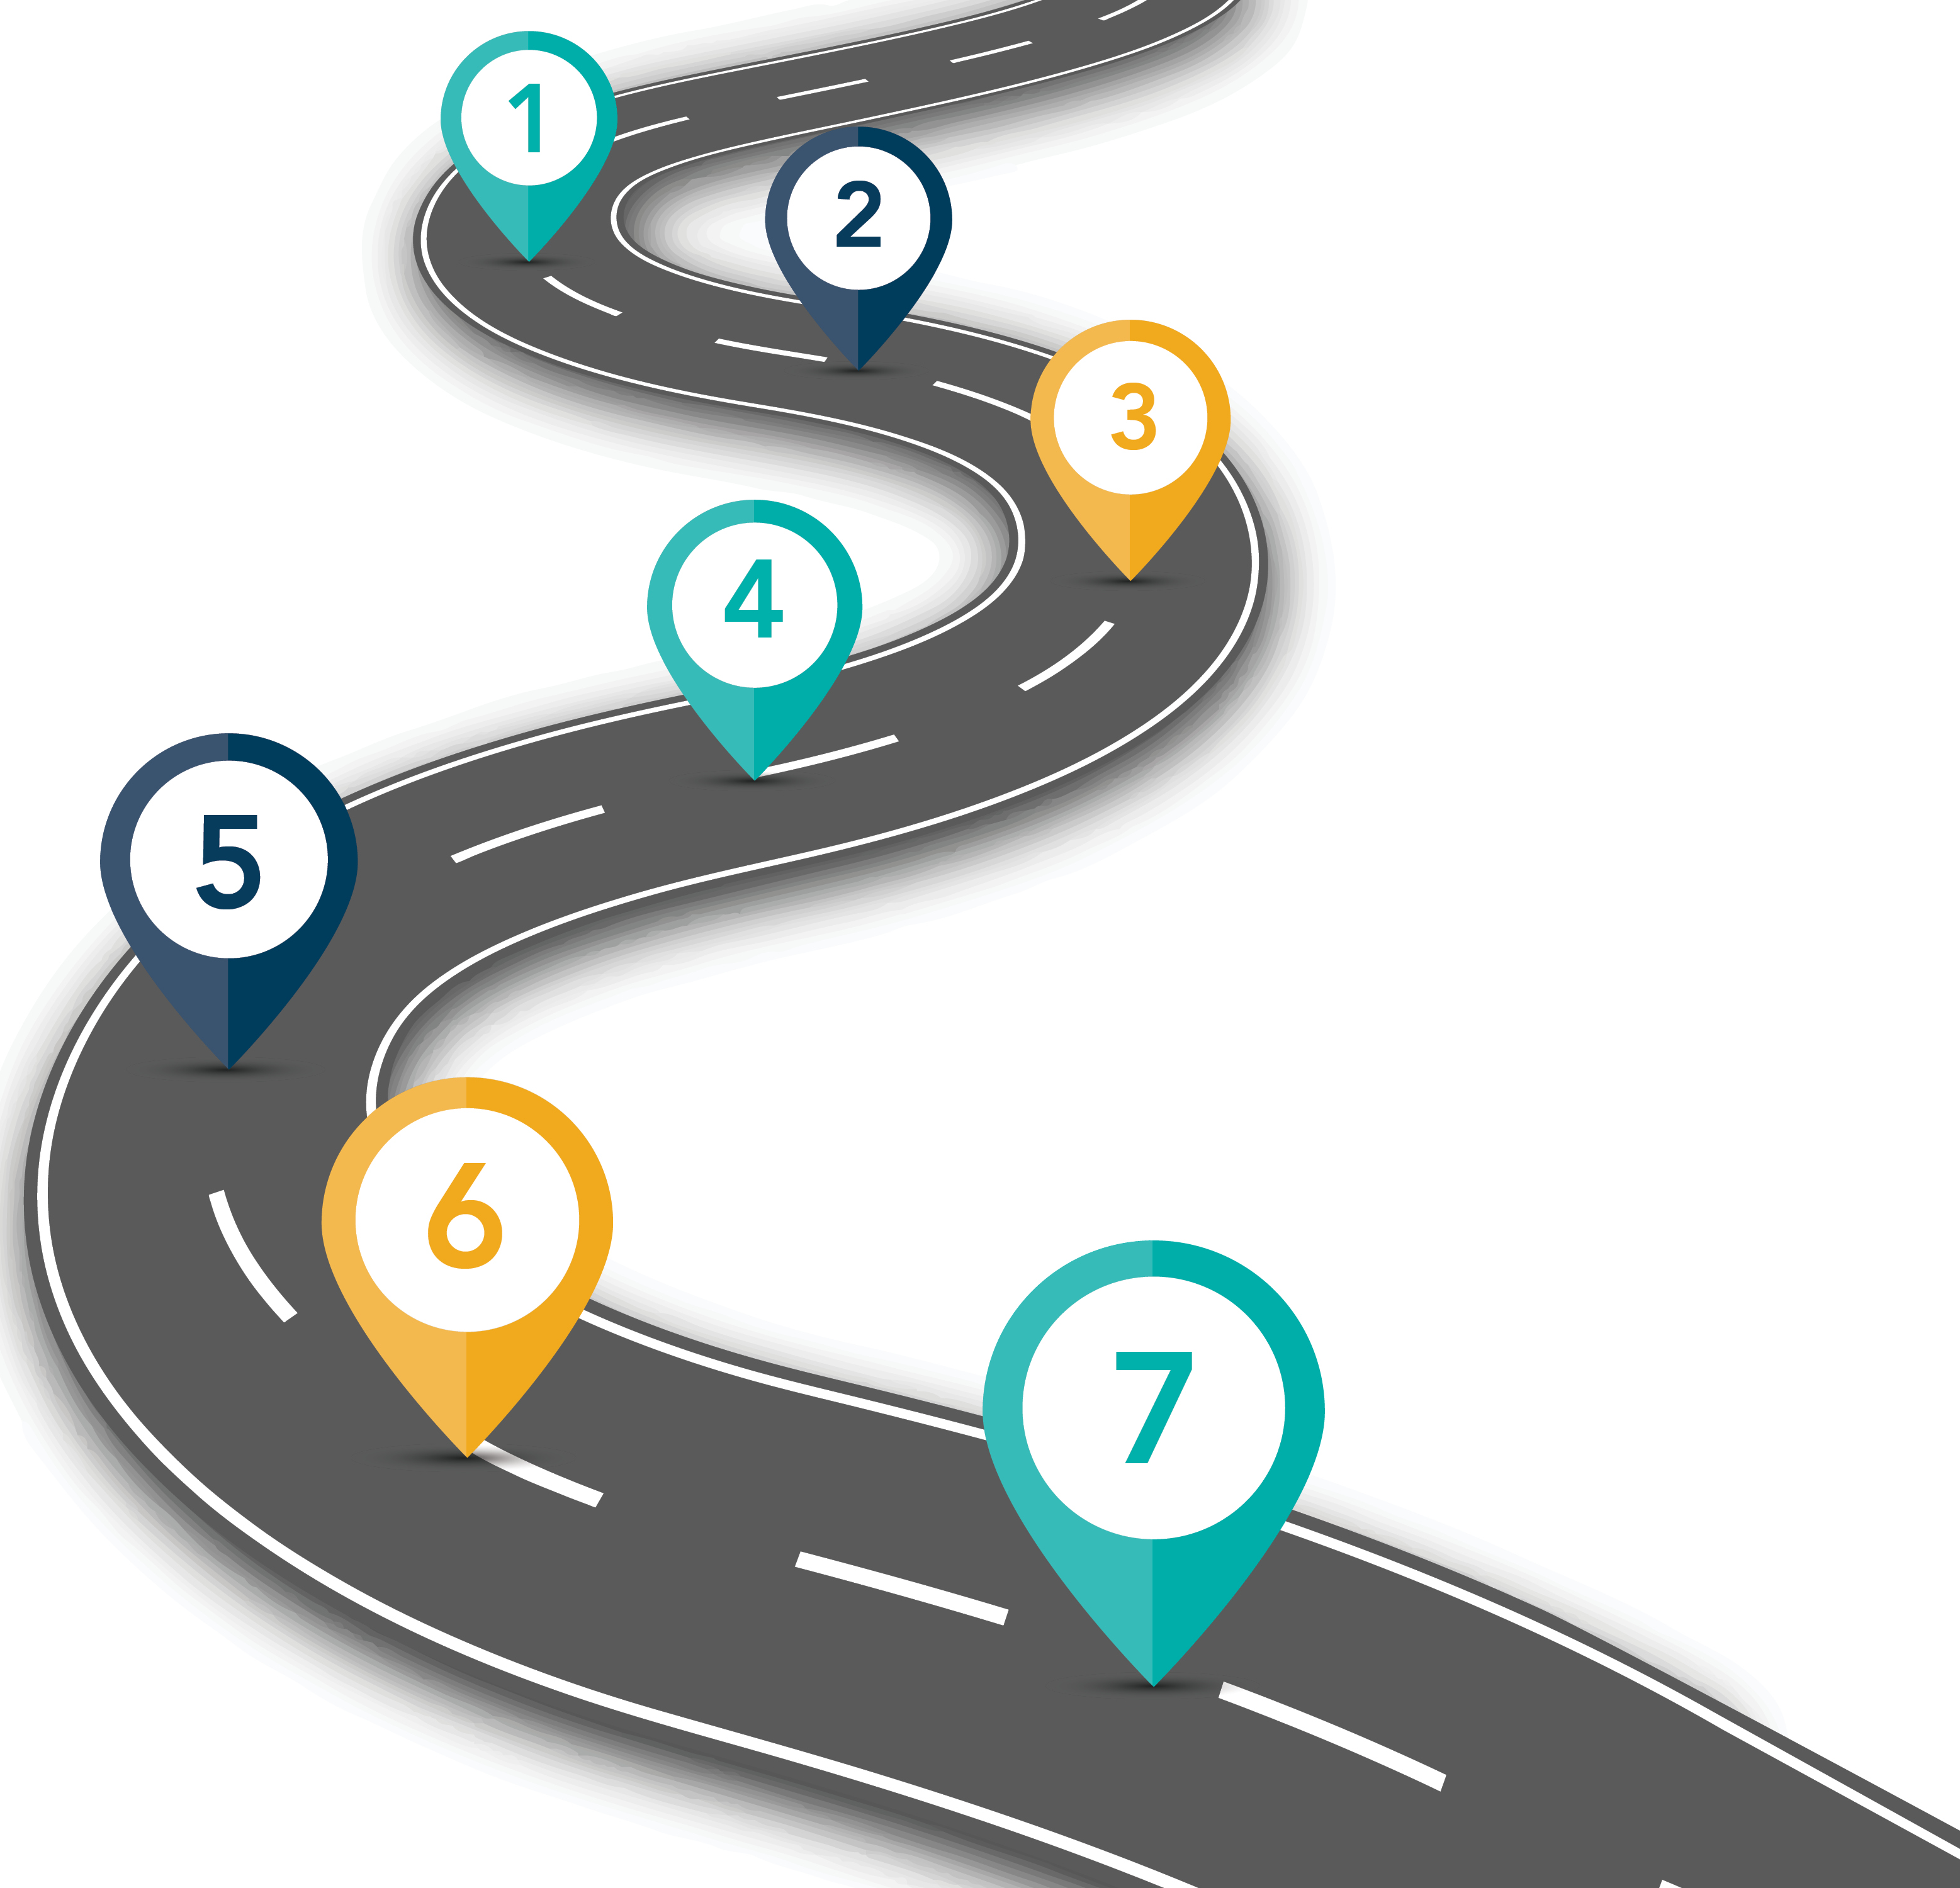
Defining the Hiring Process
1
Apply
2
Application review
3
Assessments and testing
4
Interview
5
Job offer
6
Pre-employment
7
Onboarding
Notes:
[Sanket]
Will go into brief detail about the hiring process

Slide 12
Most Common Hiring Questions
How would you describe the culture there? | How much team collaboration can I expect?
What do you like about working at CSC? | What does the career path look like for this role?
Notes:
[Sanket]
Talks about how these are the most common questions our group has received at this time.
Sanket will pass the questions to the panel to briefly answer.

Slide 13
April 21, 2025 | Proprietary and Confidential
13
Notes:
[Saray]
Tips for acing the interview – We’ve included some helpful tips for how to bring your best self to an interview here. *Can go through each of these briefly
Guys, are there any additional tips you would recommend?
*Each speaker can weigh in

Slide 14
What do you want to know?
Notes:
[Sanket]
Will now ask if anyone has any questions and open up answers to the panel.
Should no one have questions Justin will read off of the list of candid questions and leave the panel to answer.

Slide 15
Follow Us on Social Media
@CSCSince1899 @corptax
@CSCGLOBAL @joincsc
@CSCDBS @corptaxsoftware
CSC– cscsince1899
CSC Fund Solutions
CSC Global Capital Markets
CSC Business Administration and Compliance
CSC Digital Brand Services
CSC Corptax
Notes:
[Sanket]
As a reminder, please stay connected with us via social media, and be sure to sign up as part of our talent community. You’ll receive emails related to upcoming webinars, award wins, openings, and more.

Slide 16
Thank You.

