Slide 1
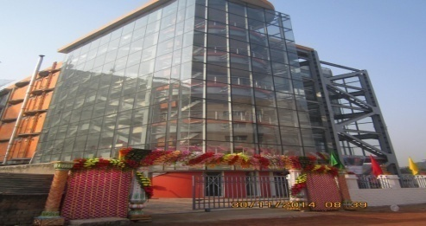
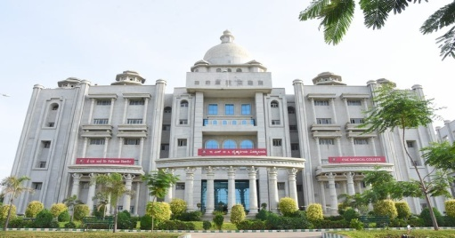
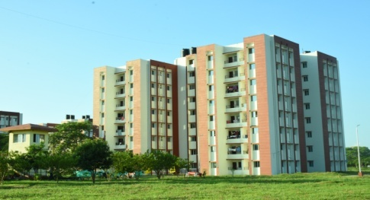
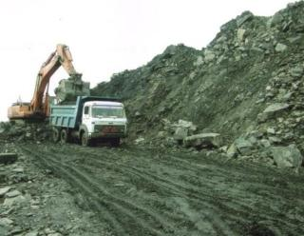
Hindustan Steelworks Construction Limited
A Govt. of India Undertaking
A Mini Ratna Cat- I Company
A Subsidiary of NBCC (India ) Ltd

Slide 2
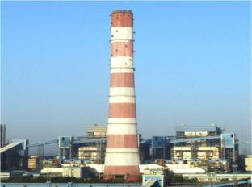
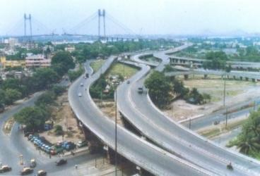
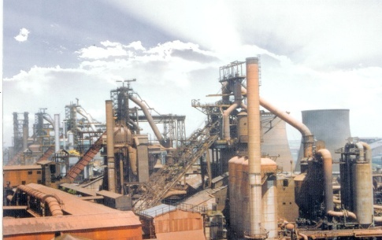
Hindustan Steelworks Construction Limited
Vision
To establish HSCL as an integrated Engineering, construction and project management consultancy company in diverse areas of infrastructure & construction sector aiming to accelerate sustainability and providing excellence with transparent governance.
Mission
To promote productivity and professionalism both at industrial as well as organizational level and continue to be the building block of the nation by providing high quality, sustainable infrastructure development through innovative & world-class construction solutions and optimizing value for all stakeholders and providing utmost customer satisfaction.

Slide 3
PAN India Presence
HSCL PAN India
Dehradun
Agartala
Delhi
32 Offices across
09 zonal offices
Varanasi
Manipur
Patna
Chandigarh
Arunachal
Sikkim
Churu
Guwahati & Tezpur
Ahmedabad
Shillong
Mumbai
& Nagpur
Bokaro
& Ranchi
Salem
Head Office
Aizwal
Bengaluru, Gulbarga
Kolkata -HO
Zonal Office
Hyderabad
& Vizag
Bhilai
Unit Office
Chennai, Salem
& Tutticorin
Bhubaneswar

Slide 4
Hindustan Steelworks Construction Limited (HSCL)
Incorporated in the year 1964, Hindustan Steelworks Construction Limited (HSCL) is a leading CPSE initially established with a mandate of developing and sourcing indigenous capabilities for setting up of Integrated Steel Plants in India.
HSCL immensely contributed in setting up every major public sector steel plant in the country over the last 5 decades.
The company has diversified into other areas of civil & construction sector like buildings, roads and highways, dams and bridges, power plants, hospital and education infrastructure, Opencast Mining, stadiums & other sports facilities, Solar Power Generation Units, etc. establishing its comprehensive credibility across the country.

Slide 5
Hindustan Steelworks Construction Limited (HSCL)
HSCL is a subsidiary of NBCC (India) Limited under the Ministry of Housing and Urban Affairs, Govt. of India.
It is a Schedule ‘B’CPSE. NBCC holds 51% stake in the company while rest of the stake is held by Govt . of India.
The company is headquartered in Kolkata and has units all over India.

Slide 6
Hindustan Steelworks Construction Limited (HSCL)
Management Trainee (E-1)
Role & Responsibilities
The person will be responsible for finalization of accounts and consolidation of accounts including financial reporting, preparation and monitoring Budgets at the unit/ corporate level including initiative for cost control.
Managing direct and indirect taxes.
Handling internal, statutory and government audits.
The work will also involve Treasury Management, Contract management & processing of contractor's / vendor's bills.
On successful completion of probation of one year, the candidate shall be posted as Assistant Manager (Finance.)

Slide 7
Hindustan Steelworks Construction Limited (HSCL)
Management Trainee (E-1)
Eligibility & Selection Procedure
Minimum Eligibility:
Passed the Final Examination of The Institute of Cost Accountants of India.
Maximum Age: 29 years as on 01.02.2022.
Candidate should be willing to re-locate anywhere in India. Employees may be transferred anywhere in India.
* Selected candidates will be required to furnish Surity Bond of Rs. 1.5 Lakhs to ensure that he/ she shall serve the organisation for a period of 2 years.

Slide 8
Hindustan Steelworks Construction Limited (HSCL)
Management Trainee(Finance) (E-1)
Scale of Pay: Rs. 40,000-1,40,000/-
CTC
Particulars | Amount
Monthly:
Basic | 40000
Dearness Allowance | 11760
House Rent Allowance | 10800
EPF | 6211
Grand Total | 68771
Yearly | 825254
Annual:
Earned leave | 51739
Half Pay Leave | 17205
Medical OPD | 8000
Retirals:
Gratuity | 29876
CTC | 932075
Rate of Dearness Allowance is declared by DPE every quarter and is based on AICPI. Presently it is 29.4%.
Medical reimbursement for special & chronic diseases is unlimited for self & family.
Medical insurance for Rs. 4 Lakhs for self & family. For treatment beyond insurance limit, medical reimbursement applicable.
Perks and Performance related Pay (PRP) shall be paid as per rules, whenever applicable.
Encashment of leaves shall be as per rules of the Company.
Employees posted in Bokaro, Bhilai & Durgapur may be provided with company’s quarters.

