Slide 1

The Institute of Cost Accountants of India
Statutory Body under an Act of Parliament
Behind Every Successful Business Decision, there is always a CMA
www.icmai.in

Slide 2

Mission & Vision
MISSION
CMA professionals would ethically drive enterprises globally by creating.
value to stakeholders in the regulatory context through competencies drawn.
from the integration of strategy, management and accounting acquired.
through focused training and continuous education.
VISION
CMAs would be the preferred source of resources and professionals for the
Financial Leadership of enterprises globally.
www.icmai.in

Slide 3
Vital Statistics
Second largest CMA body in the World.
Largest CMA body in Asia
4 Regional Councils (Delhi, Chennai, Mumbai & Kolkata)
114 Chapters across India
62 CMA Support Centres
11 Overseas Centres
About 5,00,000 students
More than 90,000 qualified professionals
in employment & practice.
www.icmai.in

Slide 4
Standards Setting Body
The Institute has set up following two Standards Setting Bodies:
Cost Accounting Standards Board (CASB):
Pioneer in issuing Cost Accounting Standards in the world
Cost Auditing and Assurance Standards Board (CAASB)
Cost Auditing Standards are mandated by the Companies Act 2013
www.icmai.in

Slide 5
Major Annual Events
National Cost Convention
International Summit
National Members in Industry Conclave
National CMA Practitioners Convention
National Students Convention
National Regions and Chapters Meet
National Students Convocation
National Awards for Excellence in Cost Management & CMA Awards
www.icmai.in

Slide 6
CMA Courses & Studies
www.icmai.in

Slide 7
Why to pursue CMA ?
PURSUING CMA COURSE ENSURES:
Increased earning potential – either in Service or Profession (i.e. Practice as
CMA)
Earn while you learn
Entrepreneurship skill development
GAIN EXPERT KNOWLEDGE IN:
Costing, Pricing, Taxation, Accounting, Data analytics, Entrepreneurship,
Strategic Decision making skills, Valuation
www.icmai.in

Slide 8
CMA PROFESSIONALS EFFECTIVELY MANAGE:
Funds and resources
Facilitate stability, sustainability, growth of organization
INDUSTRY NEEDS - SKILLED AND EMPLOYABLE PROFESSIONALS:
CMA qualification enrich employable
skills amongst students through technical and industrial exposure, at the completion of each level
CMA qualification enhances employability at various sectors
www.icmai.in

Slide 9
CMA NEW SYLLABUS-2022
Based on IFAC (INTERNATIONAL FEDERATION OF ACCOUNTANTS) Guidelines
Aligned with the New Education Policy 2020
Skill Sets – KNOWLEDGE, COMPREHENSION, APPLICATION, ANALYSIS, SYNTHESIS and EVALUATION
Knowledge Pillars – Management, Strategy, Regulatory Function and Financial Reporting
Mapped with International Bodies like CIMA (UK), ACCA (UK), CMA (USA)
Aligned with UGC Curriculum
Aligned with State Boards/Central Boards-for Foundation Course
As per Industry Requirements
www.icmai.in

Slide 10
CMA Course - Notable Features
Course for working personnel -
Earn while you Learn
Can be studied along with any other academic/professional courses
Ready to serve Industry even being a Foundation/Intermediate qualified
(i.e. semi-qualified) – Earnings assured
www.icmai.in

Slide 11
Key Features
Introducing contemporary topics -
Data Analytics
Business Communication
Entrepreneurship & Start-up
Risk Management in Banking & Insurance
Lean Accounting
Six Sigma
Forensic Audit
Information Systems Security Audit
ESG (Environmental, Social and Governance)
Digital Strategy
Digital Finance
www.icmai.in

Slide 12
Decision Theory
Quantitative Techniques in Decision Making
Cyber Security & Data Privacy Laws
Anti-money Laundering Laws
Financial Derivatives
International Financial Management
Equity & Bond Valuation
Business Forecasting Models
Financial Modelling
Leadership
Emotional Intelligence and many more...
www.icmai.in

Slide 13
Content of Syllabus 2022
Foundation Course
Paper 1 | FUNDAMENTALS OF BUSINESS LAWS AND BUSINESS COMMUNICATION (FBLC)
Paper 2 | FUNDAMENTALS OF FINANCIAL AND COST ACCOUNTING (FFCA)
Paper 3 | FUNDAMENTALS OF BUSINESS MATHEMATICS AND STATISTICS (FBMS)
Paper 4 | FUNDAMENTALS OF BUSINESS ECONOMICS AND MANAGEMENT (FBEM)
www.icmai.in

Slide 14
Content of Syllabus 2022
Intermediate Course
Group – I
Paper 5 | BUSINESS LAWS AND ETHICS (BLE)
Paper 6 | FINANCIAL ACCOUNTING (FA)
Paper 7 | DIRECT AND INDIRECT TAXATION (DITX)
Paper 8 | COST ACCOUNTING (CA)
Group – II
Paper 9 | OPERATIONS MANAGEMENT AND STRATEGIC MANAGEMENT (OMSM)
Paper 10 | CORPORATE ACCOUNTING AND AUDITING (CAA)
Paper 11 | FINANCIAL MANAGEMENT AND BUSINESS DATA ANALYTICS (FMDA)
Paper 12 | MANAGEMENT ACCOUNTING (MA)
www.icmai.in

Slide 15
Content of Syllabus 2022
Final Course
Group – I
Paper 13 | CORPORATE AND ECONOMIC LAWS (CEL)
Paper 14 | STRATEGIC FINANCIAL MANAGEMENT (SFM)
Paper 15 | DIRECT TAX LAWS AND INTERNATIONAL TAXATION (DIT)
Paper 16 | STRATEGIC COST MANAGEMENT (SCM)
Group – II
Paper 17 | COST AND MANAGEMENT AUDIT (CMAD)
Paper 18 | CORPORATE FINANCIAL REPORTING (CFR)
Paper 19 | INDIRECT TAX LAWS AND PRACTICE (ITLP)
ELECTIVES
Paper 20A | STRATEGIC PERFORMANCE MANAGEMENT AND BUSINESS VALUATION (SPMBV)
Paper 20B | RISK MANAGEMENT IN BANKING AND INSURANCE (RMBI)
Paper 20C | ENTREPRENEURSHIP AND START UP (ENTS)
www.icmai.in

Slide 16
CMA TRAINING SCHEME
Intermediate Level
Final Level
World class Employablity and Skills Training Facility
Industry Oriented Training Programme (7days)
Techno Skill
Soft Skill
SAP Finance Power User
(60 Hrs)
Cambridge University Press Soft Skill Training (20 Hrs)
Microsoft Office
(40 Hrs)
E-Filing (20 Hrs)
Practical Training for 15 months
Practical Training can be started from Intermediate Level
www.icmai.in

Slide 17
Tutorial Workshop
The Institute has introduced 44 hrs Tutorial Workshop -
6 hrs for the Intermediate Course and
38 hrs for the Final Course
www.icmai.in

Slide 18
Admission to Foundation Course
Passed Class X, Eligible for admission in Foundation Course
Passed Class XII
Eligible to appear for Foundation Course Examination
Eligible for Registration to the Intermediate Course after Qualifying the Foundation Examination
www.icmai.in

Slide 19
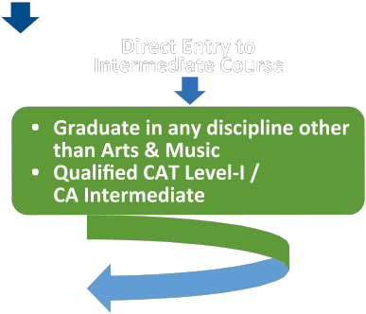
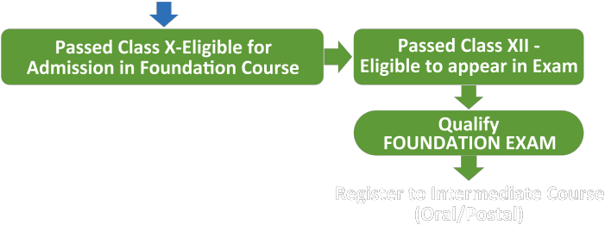
Registration to Intermediate Course
www.icmai.in

Slide 20
Registration to Intermediate Course
Qualified in Intermediate both Group
Eligible to Enroll in Final Course
www.icmai.in

Slide 21
Fees Structure
Course | Fees*
Foundation | INR 6,000
Intermediate | INR 23,100**
Final | INR 25,000**
*Oral/Postal mode of Coaching
** Installment facility available
www.icmai.in

Slide 22
Career Opportunities for CMAs
Career Opportunities for CMAs
Service
Practice
Start-up
Industry
Academia
www.icmai.in

Slide 23
Important Job Roles of CMAs
Sl. No. | Position | Sl. No. | Position
1. | CMD | 9. | Strategic Head
2. | CEO | 10. | Cost Advisor
3. | COO | 11. | Finance Controller
4. | CFO | 12. | Cost Controller
5. | Director – Finance | 13. | Risk Manager
6 | President – Finance | 14. | Business Analyst
7. | Vice President – Finance | 15. | Research Analyst
8. | Head of Finance | 16 | Dean/Professor of Finance
www.icmai.in

Slide 24
Opportunities in Administrative Services
Sl. No. | Position
1. | Indian Cost Accounting Services (ICAS)
2. | Indian Administrative Services (IAS)
3. | Indian Revenue Services (IRS)
4. | Indian Foreign Services (IFS)
5. | Indian Economic Services (IES)
6 | Indian Audit & Accounts Services (IAAS)
www.icmai.in

Slide 25
CMAs are recruited by
Sl. No. | Particulars
1. | Public sector Undertakings
2. | Infrastructure, Logistic and Automobile Companies
3. | Manufacturing, FMCG, Engineering, Hospitality, Power Sector & Telecommunication
4. | BFSI Sector
5. | IT/IT enabled Services
6. | Healthcare & Pharmaceutical Companies
7. | Big Four and Other reputed Consultancy Firms
www.icmai.in

Slide 26

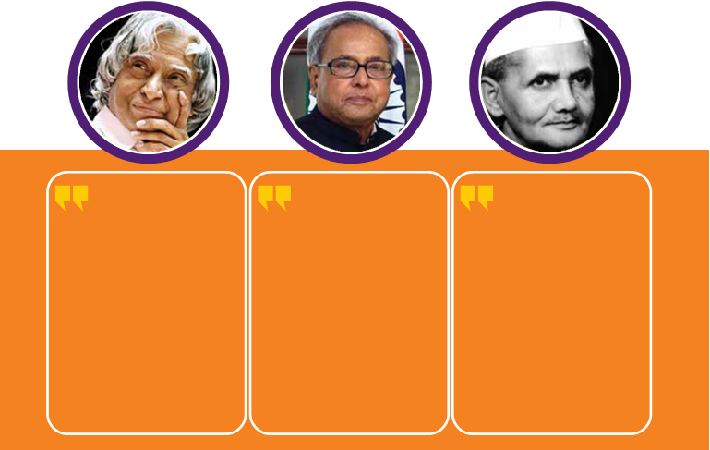
Visionaries Speak
If we have to succeed in the globalized world, we have to enlarge the scope of Cost Audit to cover all aspects of manufacturing and service sector activities including healthcare and education.”
- APJ Abdul Kalam
Former President of India
Where today’s accountants, particularly the management accountants not only has to capture the financial transactions but also has to measure, analyse, interpret and disclose the corporate economy in a holistic framework crazing the cost aspect and which is most important today’s economic structure.”
- Pranab Mukherjee
Former President of India
Without cost accountancy one works rather in a vague undefined way without knowing where an industry exactly stands but in cases where there are cost accountants, correct assessment of its proper growth & working can easily be made.”
- Lal Bahadur Shastri Former Prime Minister of India

Slide 27
Institute Motto
From Ignorance, lead me to truth
From darkness, lead me to light
From death, lead me to immortality
Peace, Peace, Peace
If we have to succeed in the globalized world, we have to enlarge the scope of Cost Audit to cover all aspects of manufacturing and service sector activities including healthcare and education.”
- APJ Abdul Kalam
Former President of India
Where today’s accountants, particularly the management accountants not only has to capture the financial transactions but also has to measure, analyse, interpret and disclose the corporate economy in a holistic framework crazing the cost aspect and which is most important today’s economic structure.”
- Pranab Mukherjee
Former President of India

Slide 28
Thank You

